Slide 1
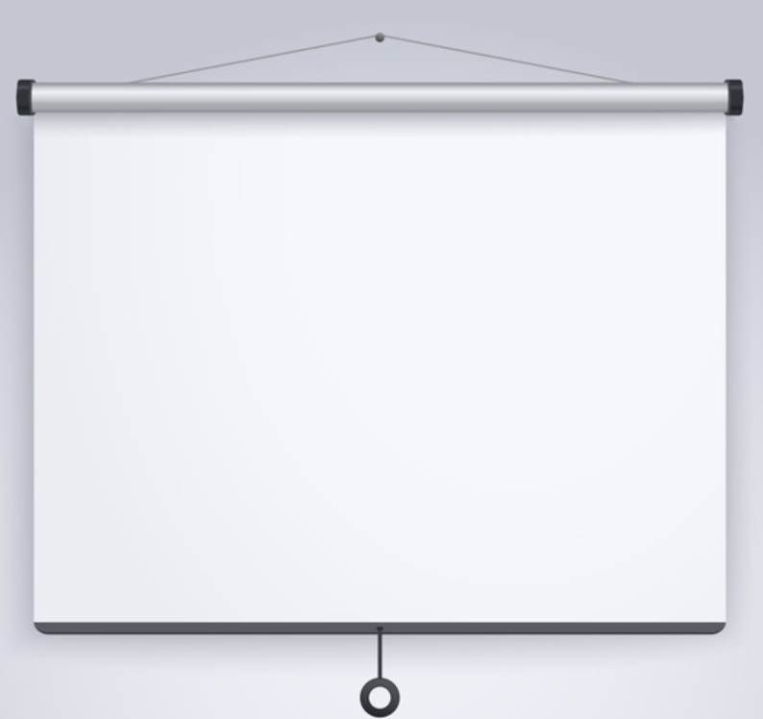

Creating a Collection
Adding Items

Slide 2
Collection
A collection is an object that holds several similar items. These items can easily be accessed and manipulated, even if there are many items within the collection.
There are already built-in collections with Excel VBA: -
Sheets
Charts
Workbooks

Slide 3
Adding Items
Collection.Add Item, [Key], [Before], [After]

